Slide 1
Quantitative Analysis

Slide 2
Qualitative vs Quantitative
Qualitative: quality (target), not quantity (measure)
Important, but hard to quantify – “I want the system to be fast”
  Tastes Great? Less Filling?
  myCourses has a user-friendly interface?
Quantitative: quantity (measure), not quality (target)
  Miller Lite beer is ___ on the International Bitterness Units scale.
  myCourses responds on average ___ milliseconds per user request.
    50 good or bad?
strongly
agree
agree
neutral
disagree
strongly
disagree

Slide 3
Tactics and Quantitative Analysis
Architectural decisions & trade-offs
  Trade-offs are introduced by decisions
  Other decisions can compensate — at a cost
Need numbers to make decisions on patterns & tactics
  Do we need to introduce caching or not?
  "Slow" is not enough
Need numbers to evaluate decisions & trade-offs
  Will caching help to reach the goal?
  "Faster" is not enough
  Compare with newly introduced trade-offs
  Compare with the price (e.g. memory cost and complexity of adding a cache)

Slide 4
Tactics and Quantitative Analysis
Qualitative is still useful
  Identifying which QA is the most important
  Screening through multiple solutions / platforms / prototypes
  Some stakeholder discussions (non-tech, e.g. prioritizing QAs, setting project goals)
Evaluation & decision-making
  Data & testable hypothesis, not creative guessing
  Expected response time < 200ms, not “fast”
  Cost per node $0.12 / hour, not “low”
  Estimated availability 99.97%, not “high”
Data, data, data!!

Slide 5
Quantitative Analysis Guidance
Data sources
  Observations (working system to be modified)
  Experiments (let’s build a prototype / skeleton)
  Modeling (let’s calculate & project)
  Rough estimates / guestimates (previous experience + expertise)
For each important QA, need characteristics / attributes, e.g.
  Performance – throughput, latency, utilization (spike tolerance & wasted money)
  Availability – compute steady state availability
mean time to failure (2000 hours)
α =
mean time to failure (2000) + mean time to repair (2 hours)

Slide 6
Quantitative Analysis Guidance
Can derive from QA scenarios, e.g.,
  Source of Stimulus (who/what initiates) – hardware fault
  Stimulus (triggering event) – server fails
  Artifact (component being affected) – application server
  Environment (condition of the event) – normal state
  Response (system reaction) – switch to backup server
  Response measure (how fast is the reaction) – 2 hours (update your resume 😮)

Slide 7
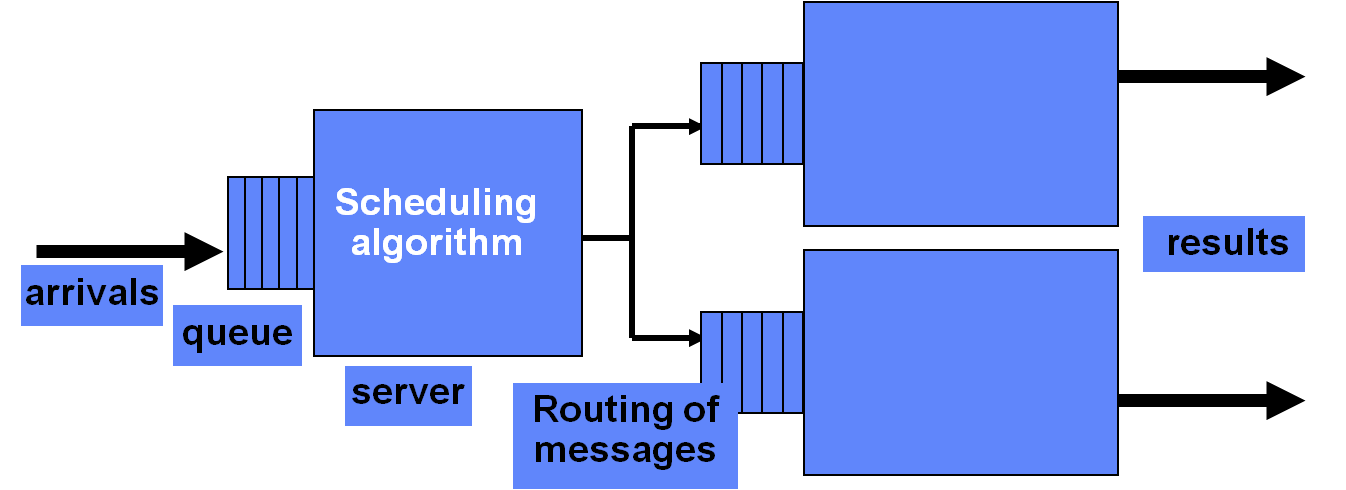
Queuing Network Analysis
Model a system as a graph of queues (edges) & service centers (nodes)
  Servers (physical)
  Networks
  Process components (software)
e.g. wait → nginx → wait → webserver → wait → database
Can calculate performance (equations from queuing theory – operations research / management study)
  70-90% accuracy vs measured results

Slide 8
Queuing Network Analysis
. . .
Departing completed request
Arriving request
Queue
Service center i
Queue
Service center j
Each request
  Enters the queue
  Waits until the service center is available
  Processed by the service center
  Routed onward (or back – response)
The caller can wait for the whole chain to be executed
  Or not – depending on an architecture & implementation (e.g. fire-and-forget)
    → scalability (scale service centers independently)

Slide 9
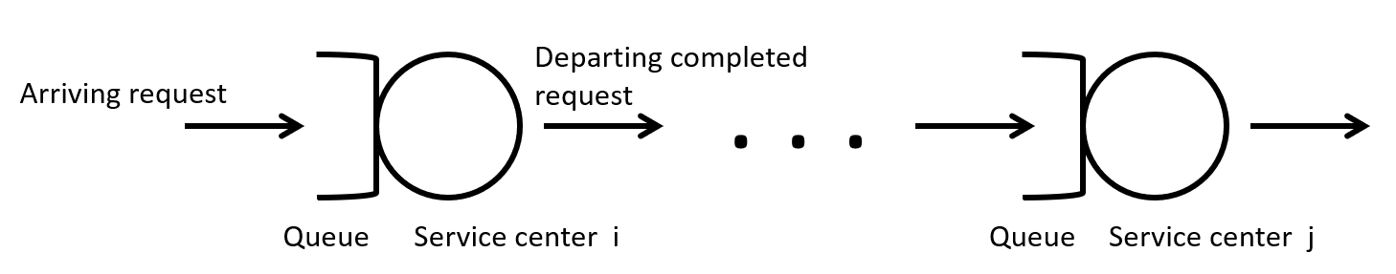
Queuing Network Analysis
Estimate or measure
  The request arrival rate (λ)
  The service rate (requests processed in a unit of time, μ)
Standard equations from queuing theory give performance measures:
  Service center utilization (% busy)
  Residence time – average time spent at the service center (queuing + service); ≈ perceived response time
    → low utilization → lower response time (queuing is shorter)
  Queue length (how many requests are waiting); if high → add service center instances
  Throughput – rate requests pass through the service center
Run “what if” experiments by varying λ and μ - modeling
Tool: http://jmt.sourceforge.net/
Quantitative System Performance, Lazowska, et al

Slide 10
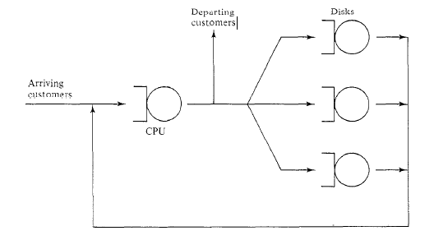
Queuing Network Example
For each service center: calculate utilization, residence time, queue length, and throughput (see slide 9). Mixed open/closed model — some requests depart on completion; others loop back and recirculate.

Slide 11
Queuing Network Example
Fries Prep
Order Accepting
Assembling Order
Order Pickup
Burger Prep
Customers arrive at Order Accepting (left) and depart after Order Pickup (right). Fries Prep and Burger Prep are parallel service centers. For each node: calculate utilization, residence time, queue length, and throughput — which is the bottleneck?

Slide 12
Utilization and Wait Time Example
  Moonbucks: 20 customers/hr arrive, served in 2 min → capacity = 30 customers/hr
  Utilization = arrivals ÷ capacity = 20 ÷ 30 ≈ 67% busy
  As utilization nears 100%, wait time doesn’t rise proportionally — it explodes
Full derivations and worked examples: see the Appendix
A 45% jump in arrivals → wait time jumps over 16×
Notes:
Mu
lambda

Slide 13
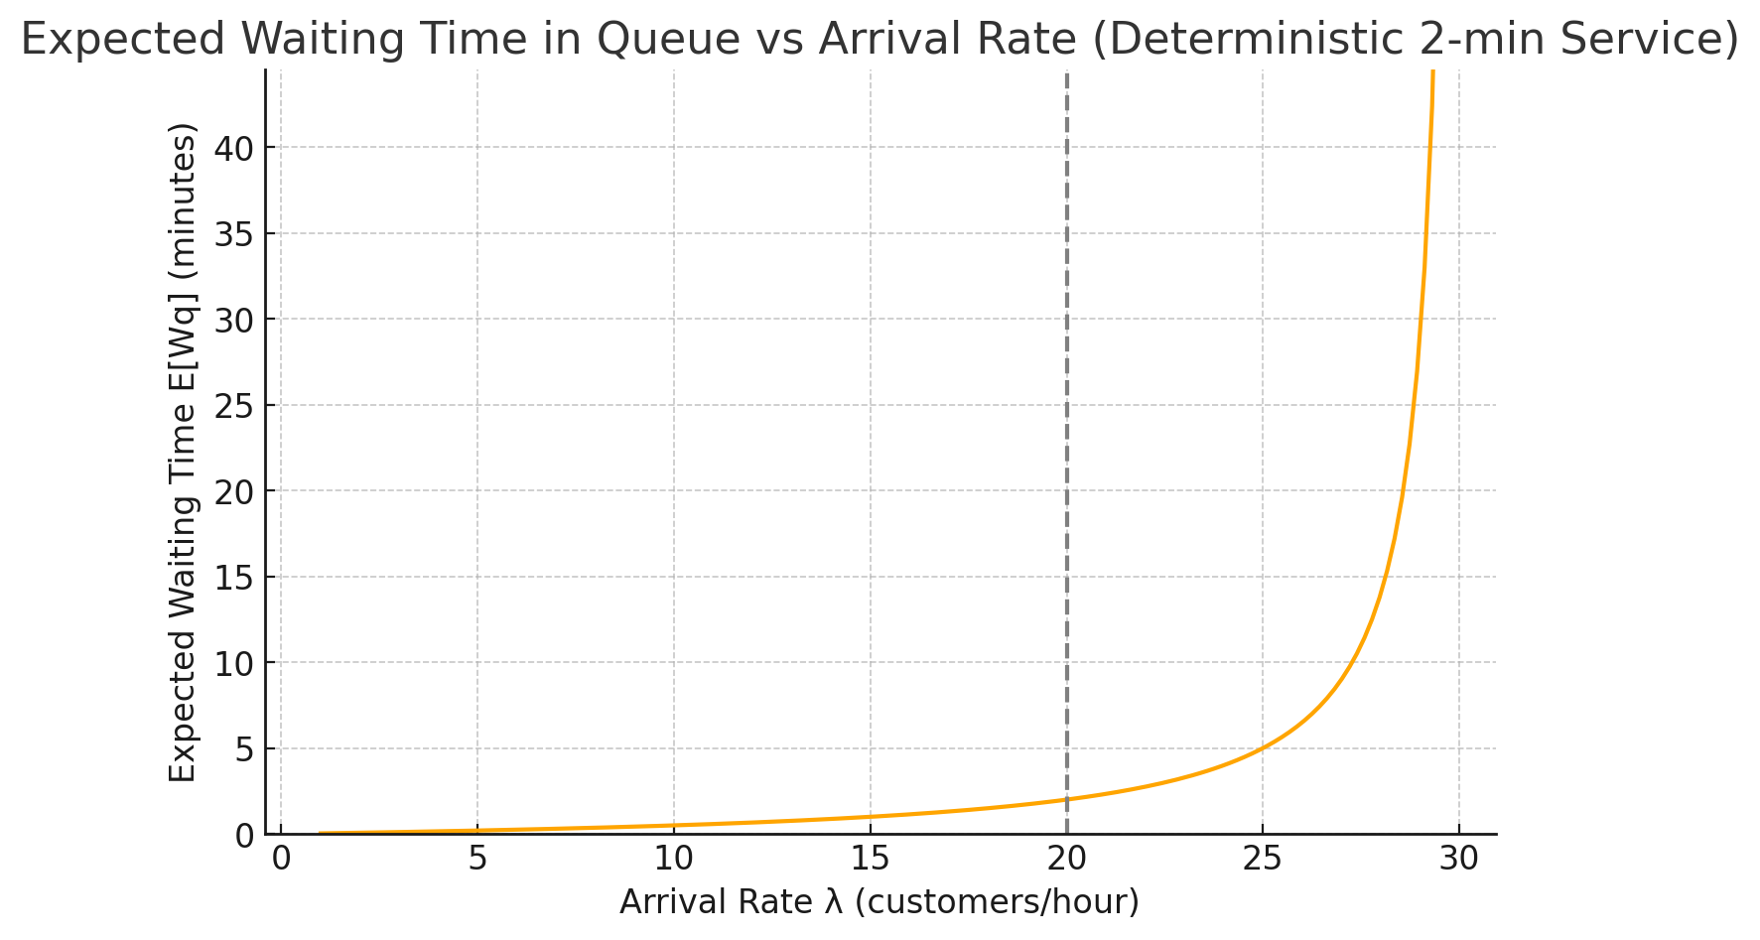
Simple Example
Current load ≈ 67%
(inside the 60–70% target)
Recommended utilization – 60-70%
Notes:
Mu
lambda

Slide 14
Another Analysis Example:
Concurrent pipelines are more realistic
  Several parallel pipelines
  Each pipeline has several steps
  All pipelines are executed on one CPU (resource contention → architectural constraint)
  Messages arrive randomly
What’s the worst-case latency for a message?
e.g. sensor data processing in a self-driving car – critical – reaction time (→ safety constraint)

Slide 15
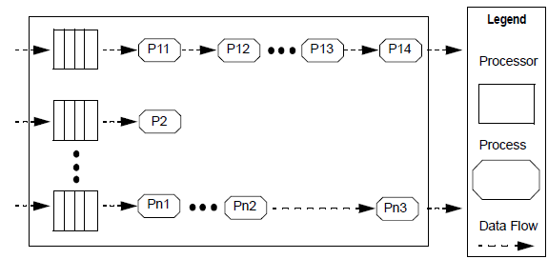
Architectural Pattern
Example Topology
FIFO

Slide 16
Performance Architectural Parameters
These five parameters determine worst-case message latency in the pipeline:
Topology: pipelines (a sequence of steps to be executed)
Preemption policy: high-priority tasks can interrupt low-priority ones
Execution time C_{i}: time to process one input at step i
Prioritization strategy: different steps have different priorities
Process scheduling discipline: priority for each step is fixed

Slide 17
Performance Architectural Parameters
What affects the worst latency the most?
Step with the lowest priority
  How long will it wait in line?
  How often will it be interrupted?
i-th pipeline is affected by interruptions from other pipelines
  → worst-case must account for all higher-priority pipelines

Slide 18
Analysis
Relate architecture pattern and tactic decisions to stimulus/response behavior (e.g., pipeline latency as QA scenario response measure)
Analysis focus – effects of process prioritization strategy on end-to-end latency?
Concurrent pipeline formal analysis:
  Computationally predict the end-to-end worst-case latency
Informal qualitative analysis heuristics
  Identify possible concurrent pipeline design issues based on experience (e.g. priority inversion, starvation of low-priority pipelines)

Slide 19
Formal Analysis Summary
Compute the worst-case latency for an input message in the i-th pipeline
  e.g. sensor fusion in a self-driving car — reaction time constraint)
Analysis
  Incremental processing of inputs
  Each process step has a fixed computational time
  Each process step executed by a different process with its own fixed priority
  Latency of a message traversing i-th pipeline depends on preemptive effect of higher-priority pipelines
  Effective priority of a pipeline is determined by the lowest priority of all processes in the pipeline

Slide 20
Latency Analysis
Worst-case latency for an input message using the i-th pipeline consisting of processes P_{i1}, P_{i2}, …, P_{im}
Determine
    Lowest priority process in the i-th pipeline, LowP_{i}
    H = pipelines that have all of their processes with priority greater than LowP_{i} (e.g. obstacle detection, emergency braking)
    HL = pipelines that start with processes of priority > LowP_{i} but eventually drop below LowP_{i}
    LH = pipelines that start with processes of priority < LowP_{i} but eventually rise above LowP_{i}
“Fixed Priority Scheduling of Periodic Tasks with Varying Execution Priority” , Klein, et al, IEEE Real Time Systems Symposium, 1991

Slide 21

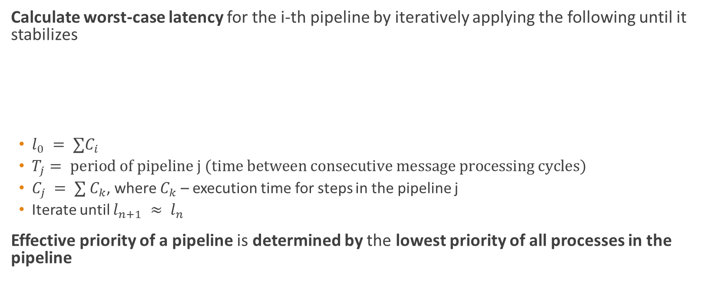
Latency Analysis (continued)
Calculate worst-case latency for the i-th pipeline by iteratively applying the following until it stabilizes
  $l_{0} = ∑C_{i}$
  $T_{j}= period of pipeline j (time between consecutive message processing cycles)$
  $C_{j} = ∑ C_{k}$, where $C_{k}$ – execution time for steps in the pipeline j
  Iterate until $l_{n+1} ≈ l_{n}$
Effective priority of a pipeline is determined by the lowest priority of all processes in the pipeline

Slide 22
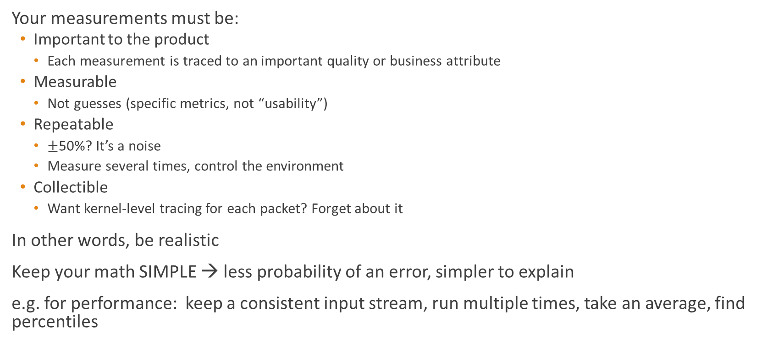
Simplifying it …
Your measurements must be:
  Important to the product
    Each measurement is traced to an important quality or business attribute
  Measurable
    Not guesses (specific metrics, not “usability”)
  Repeatable
    $±$50%? It’s a noise
    Measure several times, control the environment
  Collectible
    Want kernel-level tracing for each packet? Forget about it
In other words, be realistic
Keep your math SIMPLE → less probability of an error, simpler to explain
e.g. for performance: keep a consistent input stream, run multiple times, take an average, find percentiles

Slide 23
Simpler equations
Processing time
  min / max / avg / percentile
  Per activity / operation (e.g., video transcoding)
e.g., by domain
  Document processing – per document type (e.g., docx, pdf)
  DB – per query type
  Image – per operation type (e.g., face recognition, background classification)
e.g. concurrent pipeline — simplified analysis:
  Estimate C_{i} per step — from prototype, benchmark, or comparable system
  Estimate λ — from requirements or use-case analysis (messages/second)
  Calculate utilization: ρ_{i} = C_{i} × λ per step
  Step with ρ_{i} closest to 1.0 = bottleneck → reduce C_{i}, reduce λ, or replicate the step
  Validate with prototype experiments once available (70–90% accuracy)

Slide 24
Qualitative Analysis and Design Heuristics
Still matters – give a direction / ask questions
Latency increased by 100 ms – WHY?
  Wrong priority assignment?
    Is there another prioritization strategy to decrease latency?
    Can different architecture help with it?
Given awareness of latency performance sensitivity to prioritization strategy, ask
  How does choice of priority assignment impact latency?
  Is there another prioritization strategy to reduce latency?
  Can the architecture design accommodate reprioritization?
  Is the effect of reallocating functionality to process easily understood?
Design heuristics
  Assign higher priorities for shorter deadlines (→ Rate Monotonic Scheduling — optimal for fixed-priority preemptive systems)
  Focus on job with longest completion time, not just first job

Slide 25
Appendix
Supporting material: full queuing equations and worked examples

Slide 26
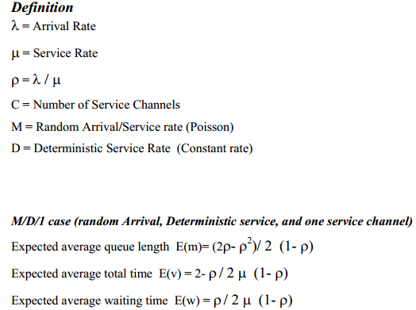
Appendix: Queuing Network Analysis
Sample Equations
← utilization
← e.g. threads
← unpredictable traffic
residence time →
Don’t memorize —
remember they exist!

Slide 27
Appendix: Queuing Model Types (M/D/1, M/M/1, M/M/c)
Sample Equations
λ (arrival rate) > μ (service rate) – system is overloaded
λ < μ – system stable
M/D/1 – Markovian/random arrivals, deterministic service, 1 channel (e.g. fixed-duration jobs, cache lookups)
  Most convenient to calculate
M/M/1 – Markovian/random arrivals, random service, 1 channel (e.g. general web requests)
  Less convenient, more realistic
M/M/c – random arrivals, random service, c channels (e.g. thread pool, DB connection pool)
  Realistic
  More complex formulas
    e.g., P(system busy), expected queue length and wait time

Slide 28
Appendix: Moonbucks Worked Example
Moonbucks
  20 customers arrive per hour (λ)
  2 minutes to serve
μ = Service Rate = 60 min/hour ÷ 2 min/customer = 30 customers per hour
What happens if the number of customers exceeds the service rate?
λ = Average Arrival Rate – either measured or estimated
Utilization: p = λ / μ = 20 / 30 ≈ 0.67
Expected Average Waiting Time
  E(w) = p / 2 μ (1 – p) = 0.67 / 2 * 30 (1 – 0.67) = 0.033 = 2 min in a line – why?
  E(w | λ = 29, p = 0.97) = 0.97 / 2 * 30 (1 – 0.97) = 32.33 min 😮
    A 45% increase in average arrival wait results in a 1517% increase in average wait time!
Request
Completed Request
Notes:
Mu
lambda

